Slide 1
Team Overhead
Grace C, Sireesha D, Rehaan K, Pranathi R, Aadi S, Arham S, Ashar S, Nohami Z
Team Overhead
Notes:
Pranathi

Slide 2
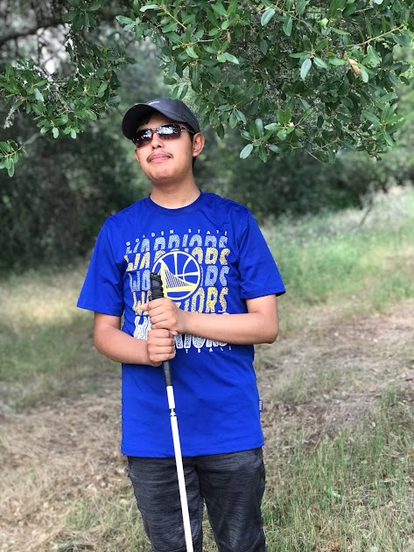
Community Partner
Community Partner: Omar
Visually impaired since he was fifteen years old
Resides at the Hatlen Center
Notes:
Pranathi
Omar is a visually impaired 18-year old. A young man in this rapidly developing society, Omar lost his eyesight at the mere age of 15. He is currently residing at the Hatlen Center, where he learns to be more independent by taking classes that teach their visually impaired students how to navigate technology, manage their finances, and more.

Slide 3
Problem
Omar uses a cane to navigate when he is outside
Cane cannot detect overhead objects
Omar must walk with his hand above his head to block objects
This problem is elevated by Omar’s tall height
Notes:
Sireesha
When Omar is outside, he typically uses a cane to navigate. However, his cane is unable to detect overhead objects, such as branches and street signs. Omar has indicated that this is one of the most pressing issues he tackles on a daily basis. He often has to walk with his hand above his head in order to shield himself from these objects, as the injuries that could occur because of them could have an exceedingly detrimental impact to him. In addition, his height only worsens the problem, as it increases the risk of him colliding with overhead objects.

Slide 4
Quotes
“. . . have to know when I’m walking, obviously you guys know there are branches sticking out of trees, signs above eye level, that obviously my cane is not going to feel, because the cane is on the ground. “
“Sometimes we use our hand, but we might know that something is there, so that is something else we sometimes have to deal with…”
Notes:
Ashar
When meeting with Omar via zoom, we got to fully understand his struggles in his day-to-day life. Some notable statements of his included…

Slide 5
Solution
Hat that can detect overhead objects to lead user to safety
Ultrasonic sensors to detect, and vibration motors to signal the user
Vibrations start when detecting obstacles 3 feet away
Vibrations get more noticeable as obstacles get closer
Notes:
Rehaan
Our solution was to create a hat that can detect overhead obstacles and in turn, lead our community partner to safety when walking on the sidewalk. When an obstacle is detected 3 feet away from the user, the user will feel vibrations, signaling them about the obstacle. The vibrations will become more noticeable as the user gets closer to the object. From this information, the user will be able to get an accurate sense of where the object is based on the frequency of the vibrations. Our product works by using ultrasonic sensors to detect these obstacles and vibration motors on the side of the hat that signal the user about the obstacles.

Slide 6
Demo
Hat that can detect overhead objects to lead user to safety
Ultrasonic sensors to detect, and vibration motors to signal the user
Vibrations start when detecting obstacles 3 feet away
Vibrations get more noticeable as obstacles get closer
Notes:
Rehaan
Our solution was to create a hat that can detect overhead obstacles and in turn, lead our community partner to safety when walking on the sidewalk. When an obstacle is detected 3 feet away from the user, the user will feel vibrations, signaling them about the obstacle. The vibrations will become more noticeable as the user gets closer to the object. From this information, the user will be able to get an accurate sense of where the object is based on the frequency of the vibrations. Our product works by using ultrasonic sensors to detect these obstacles and vibration motors on the side of the hat that signal the user about the obstacles.

Slide 7
Product Features
Inputs
Outputs
Two ultrasonic sensors mounted on the cap will take input from the world in real time.
e.g. Distance and location of objects relative to the user
Two vibration motors mounted on the cap near the user’s temples will vibrate with increasing intensity as objects move closer to the user.
Notes:
Arham

Slide 8
Feedback from Omar
“...so far, it sounds good…that actually would really work obviously in my case since I’m living by my own and I walk around sometimes…that actually would be really good.”
Notes:
Ashar
After completing a prototype of our design, we relayed our developments to Omar via Zoom. One notable statement of his was…

Slide 9
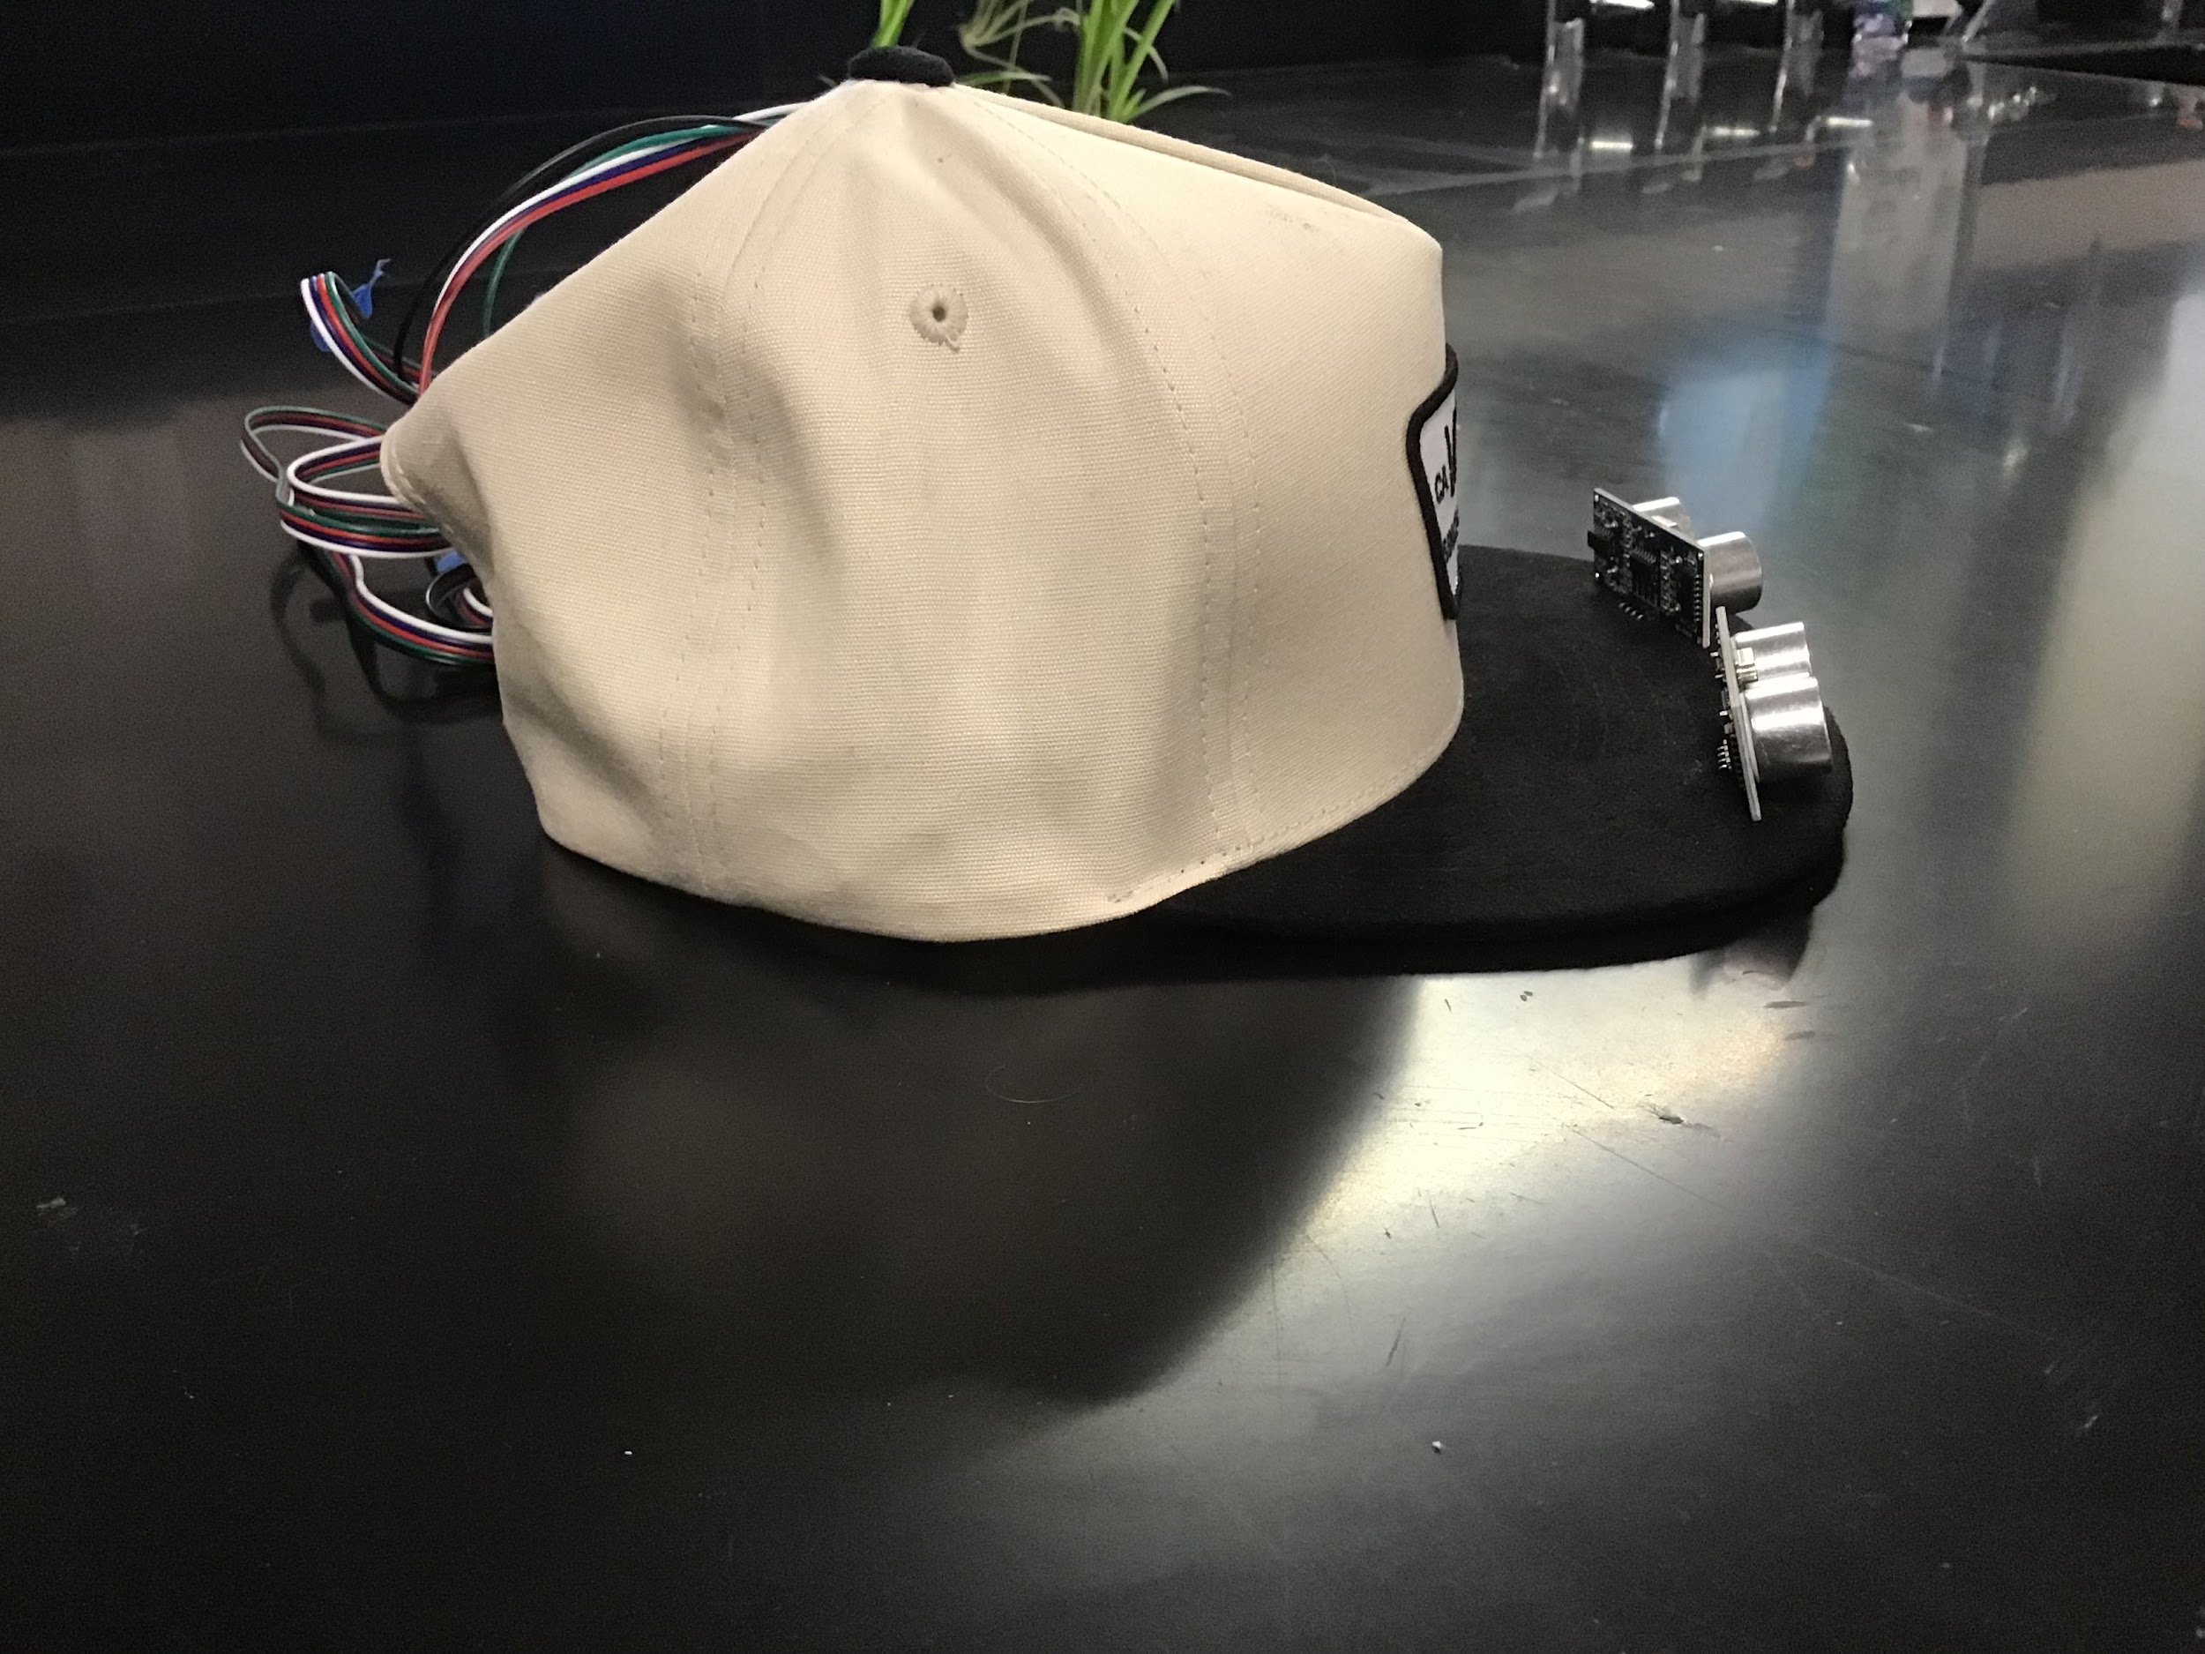
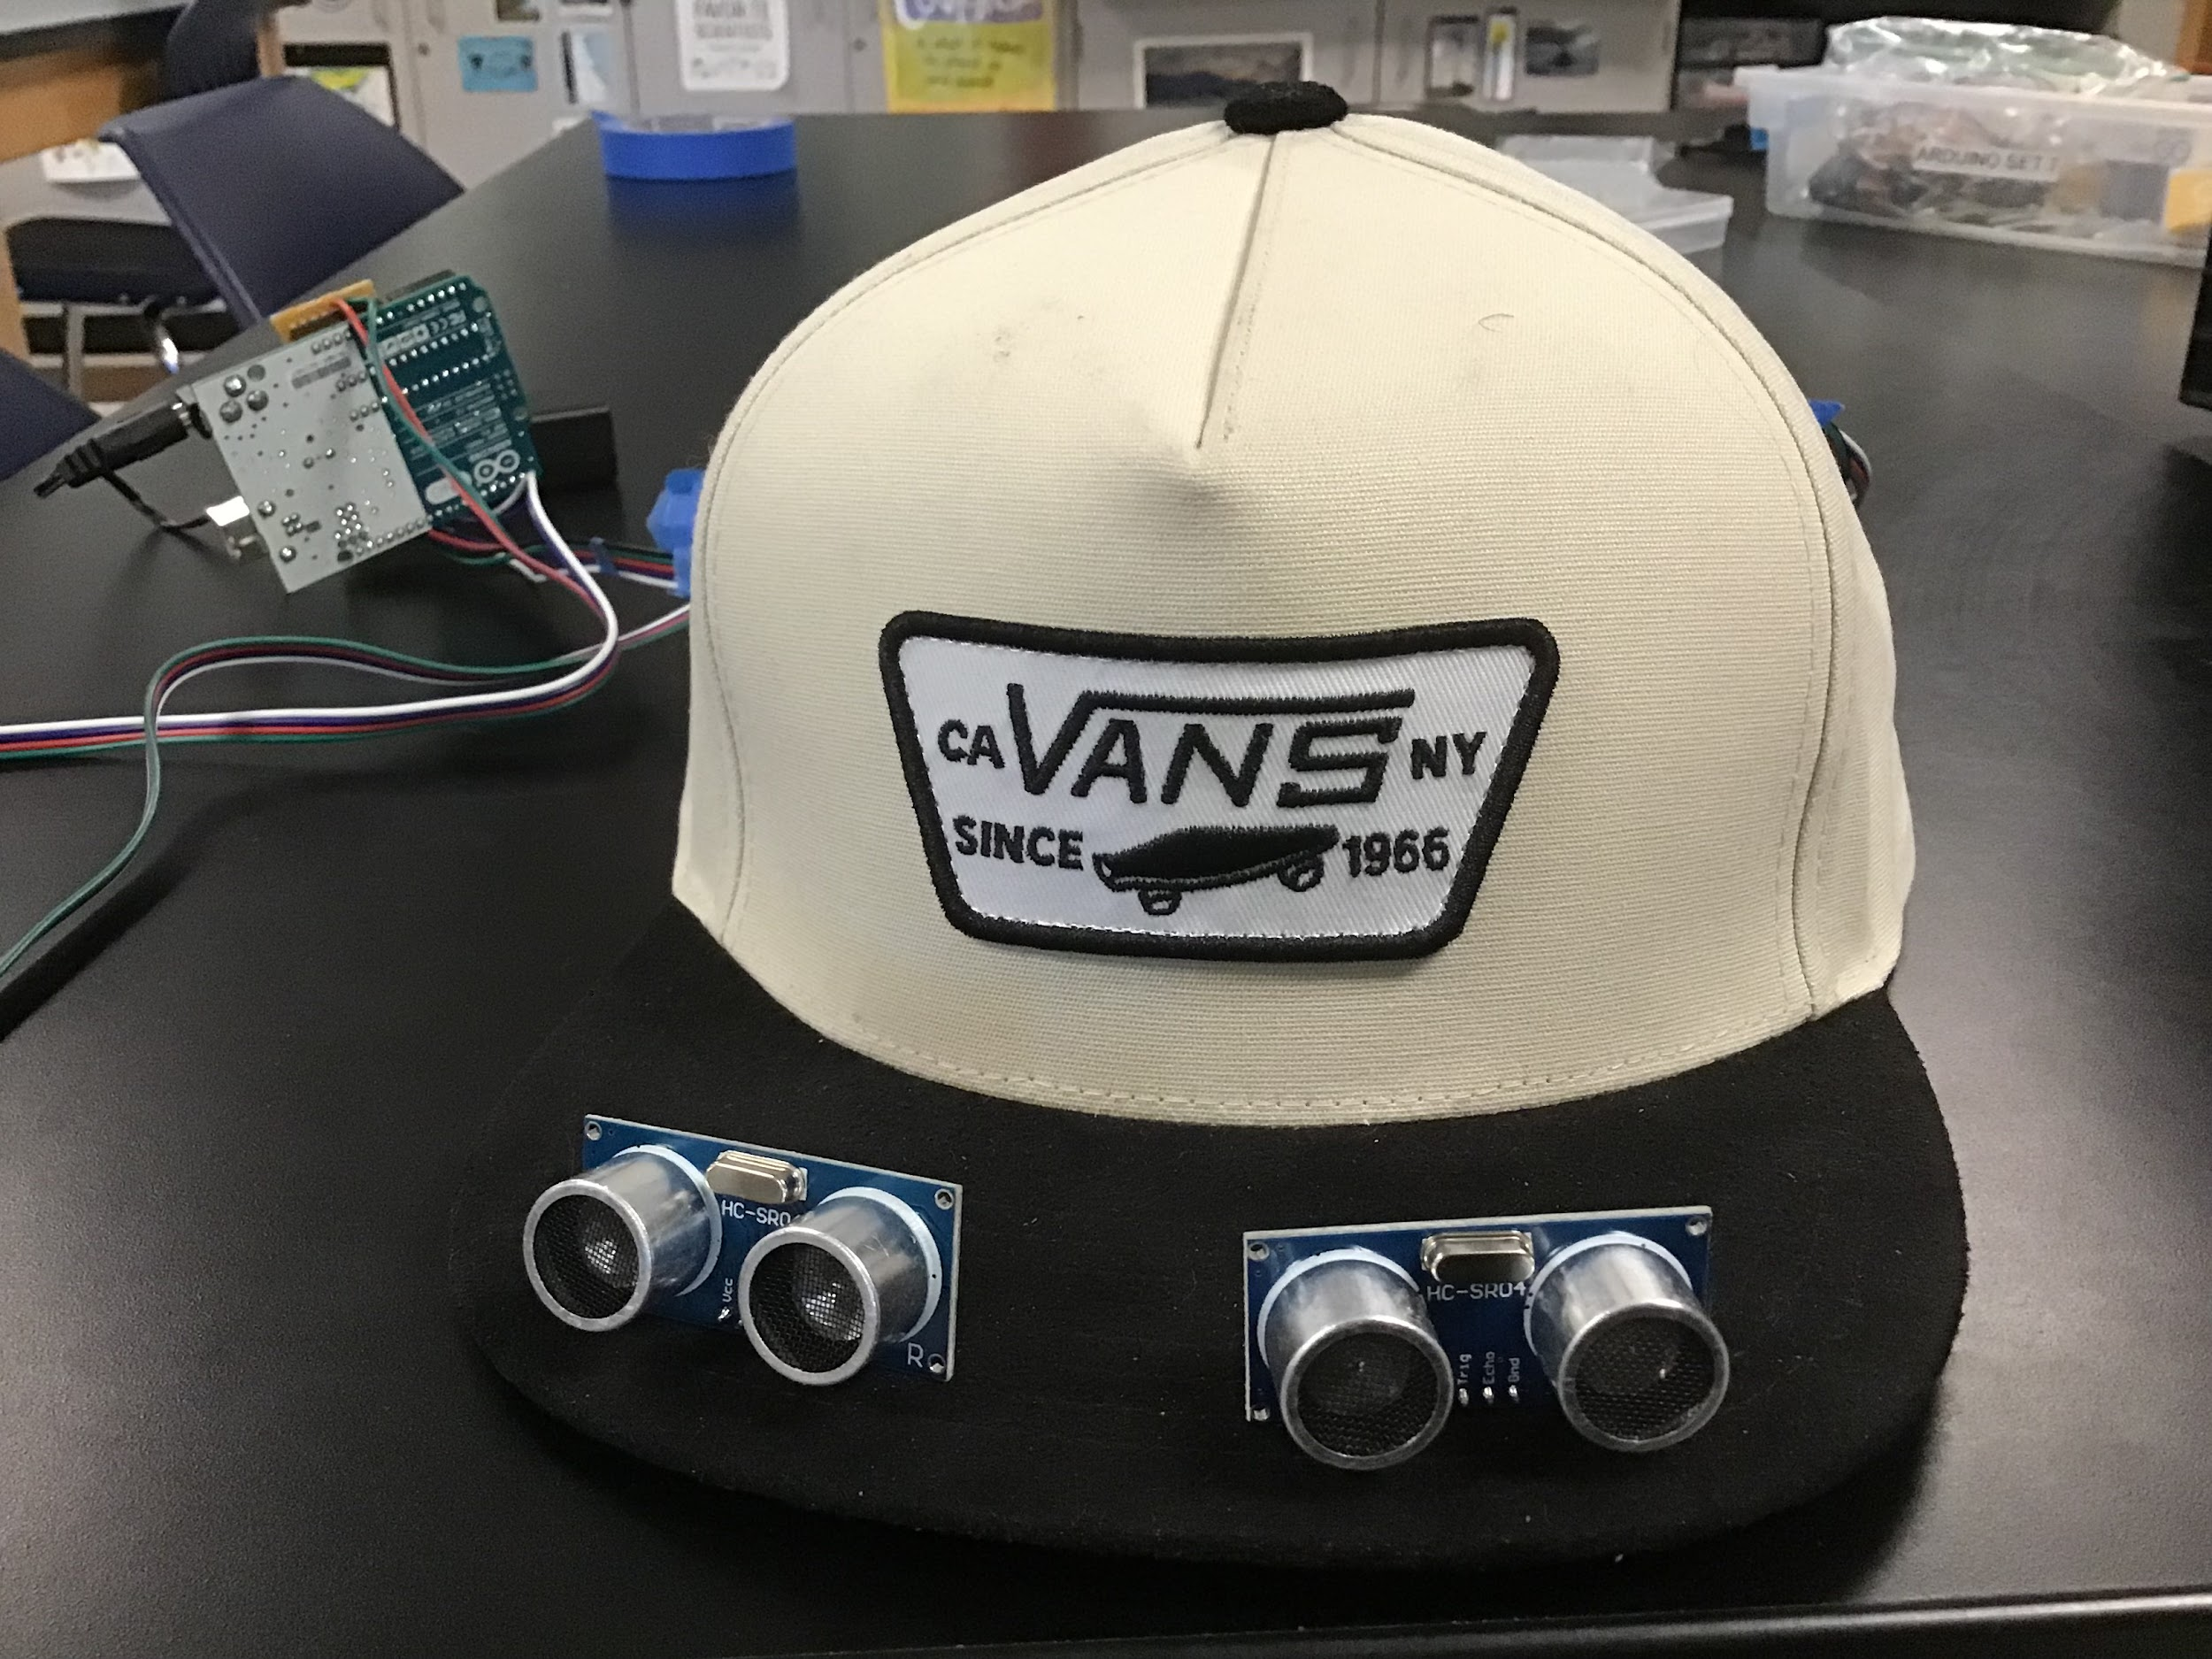
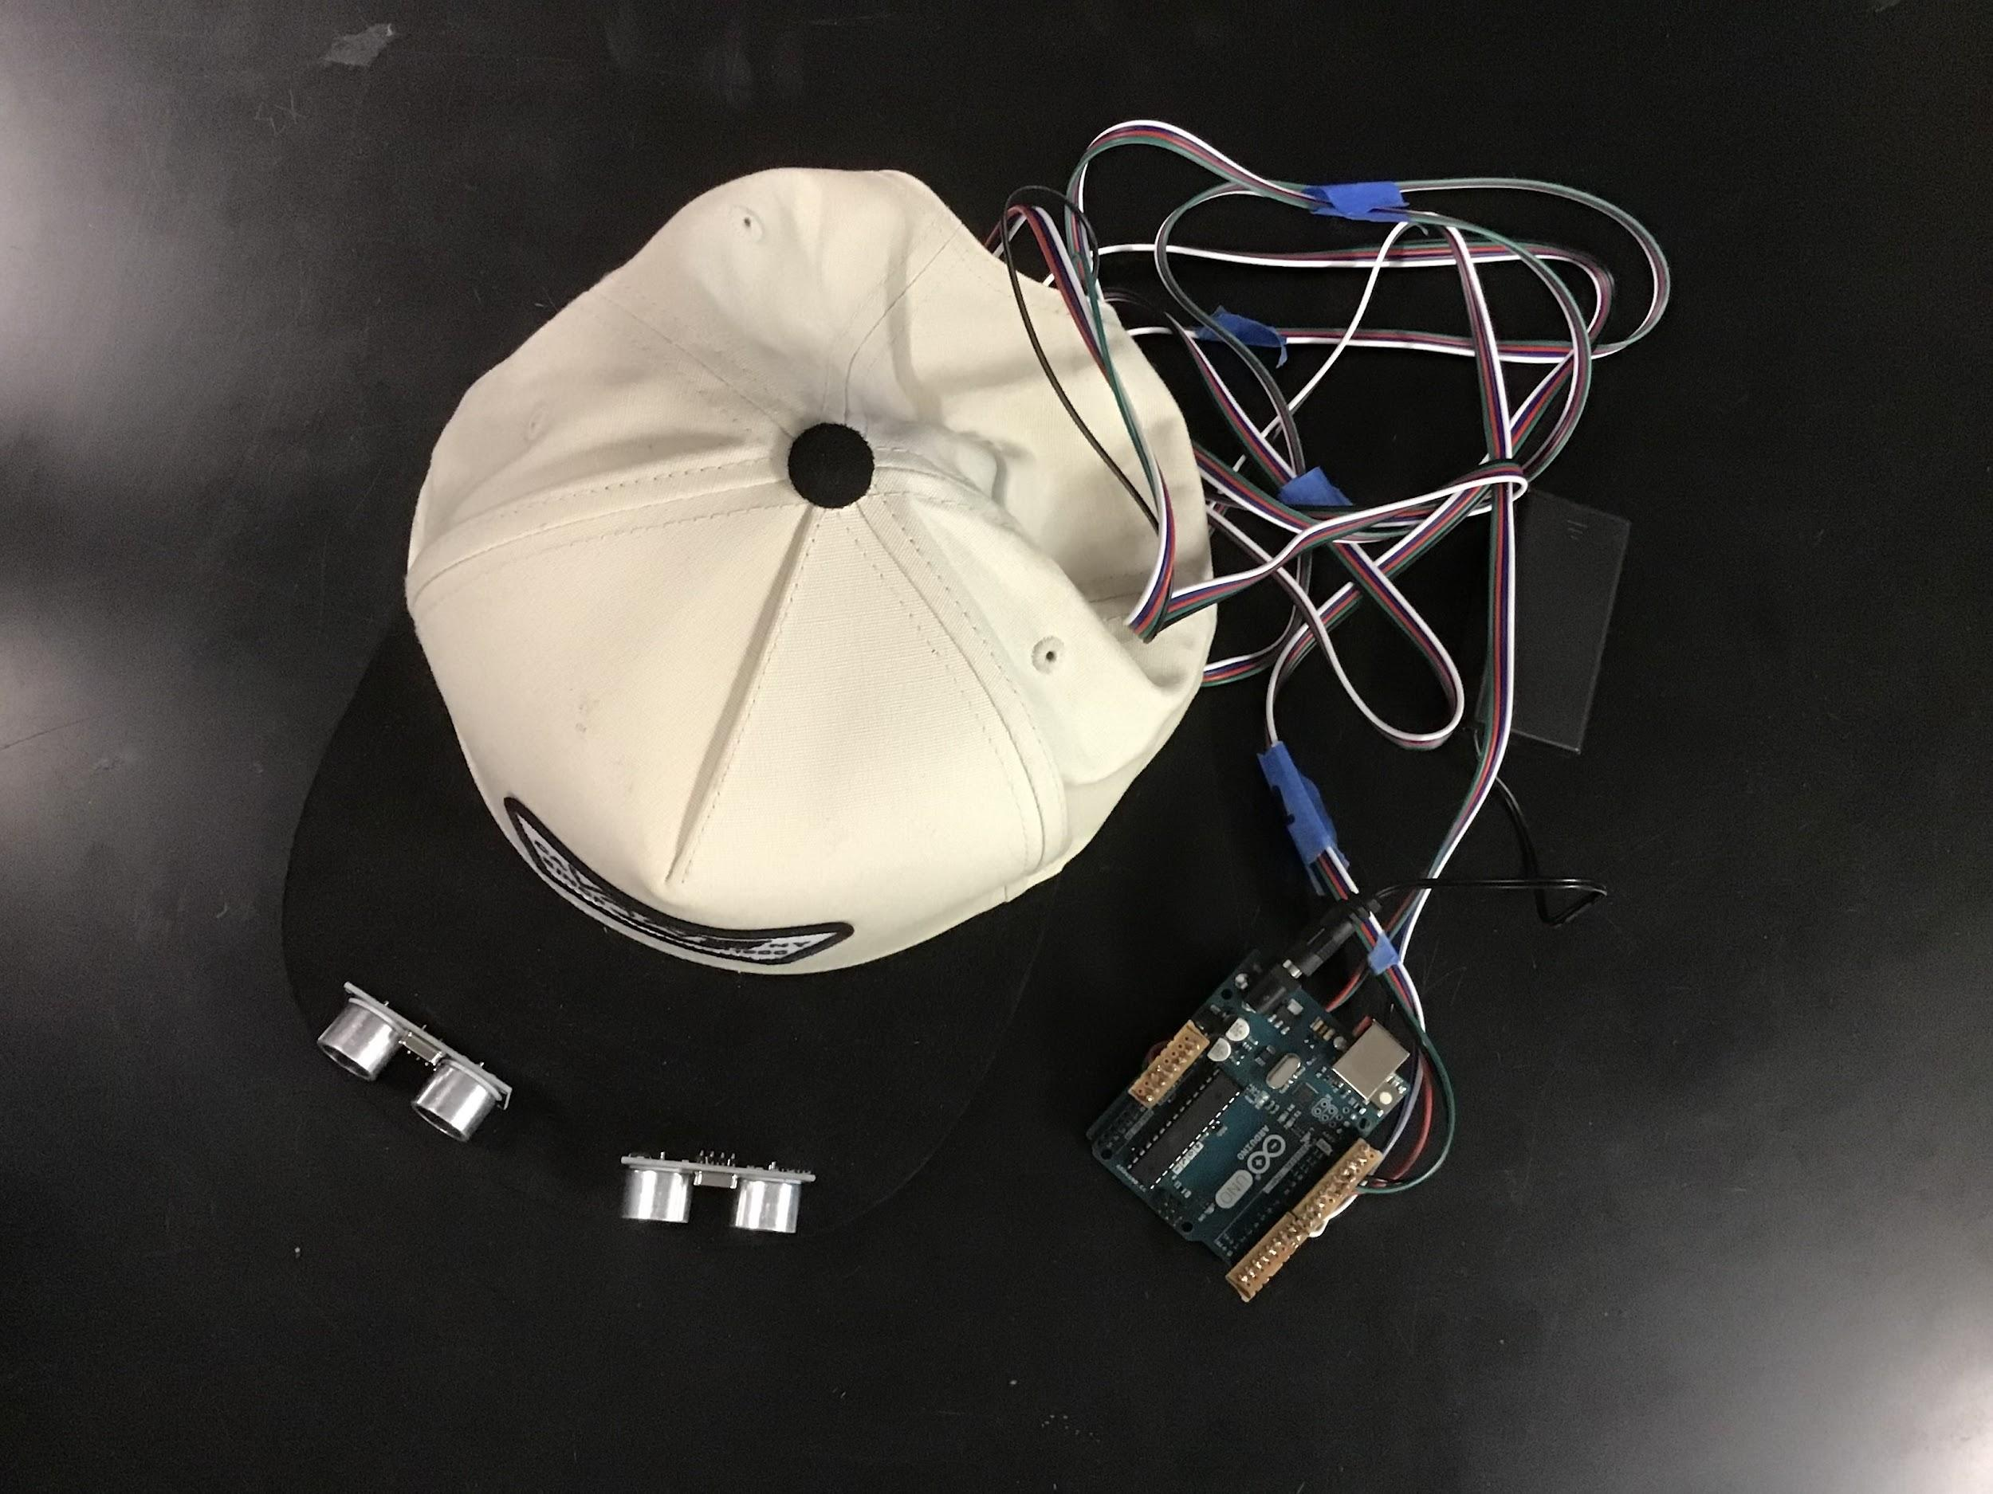
Prototype Images
Side View
Front View
Top View
Notes:
Arham

Slide 10
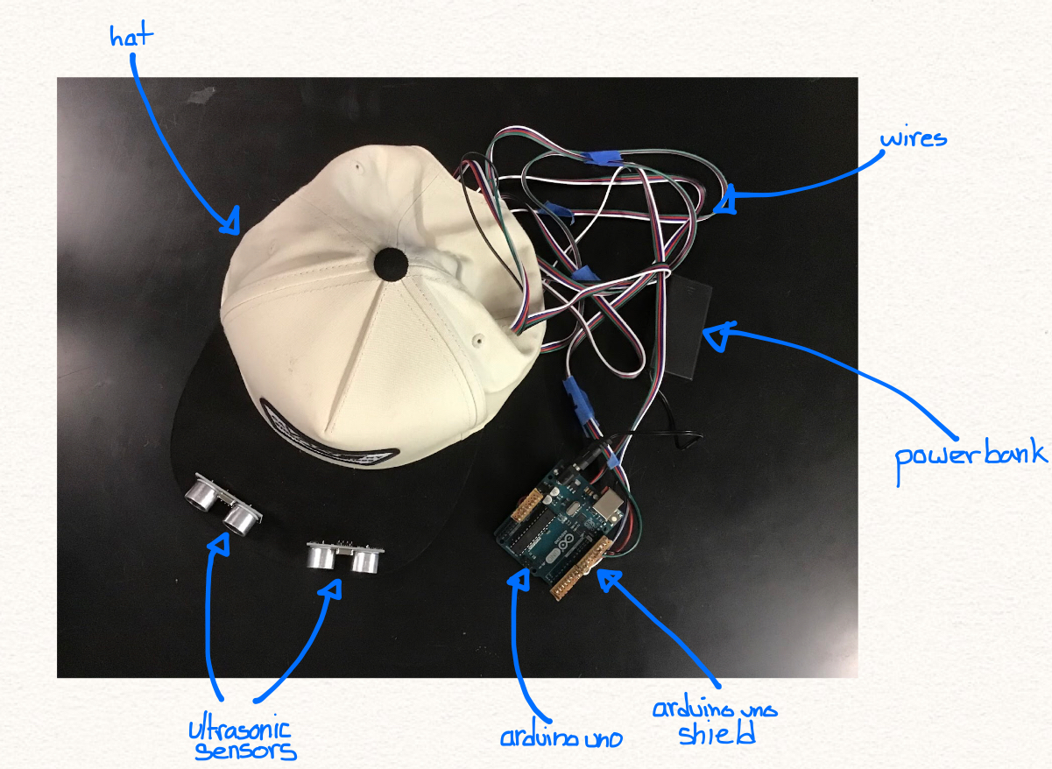
Diagram
Notes:
Arham

Slide 11
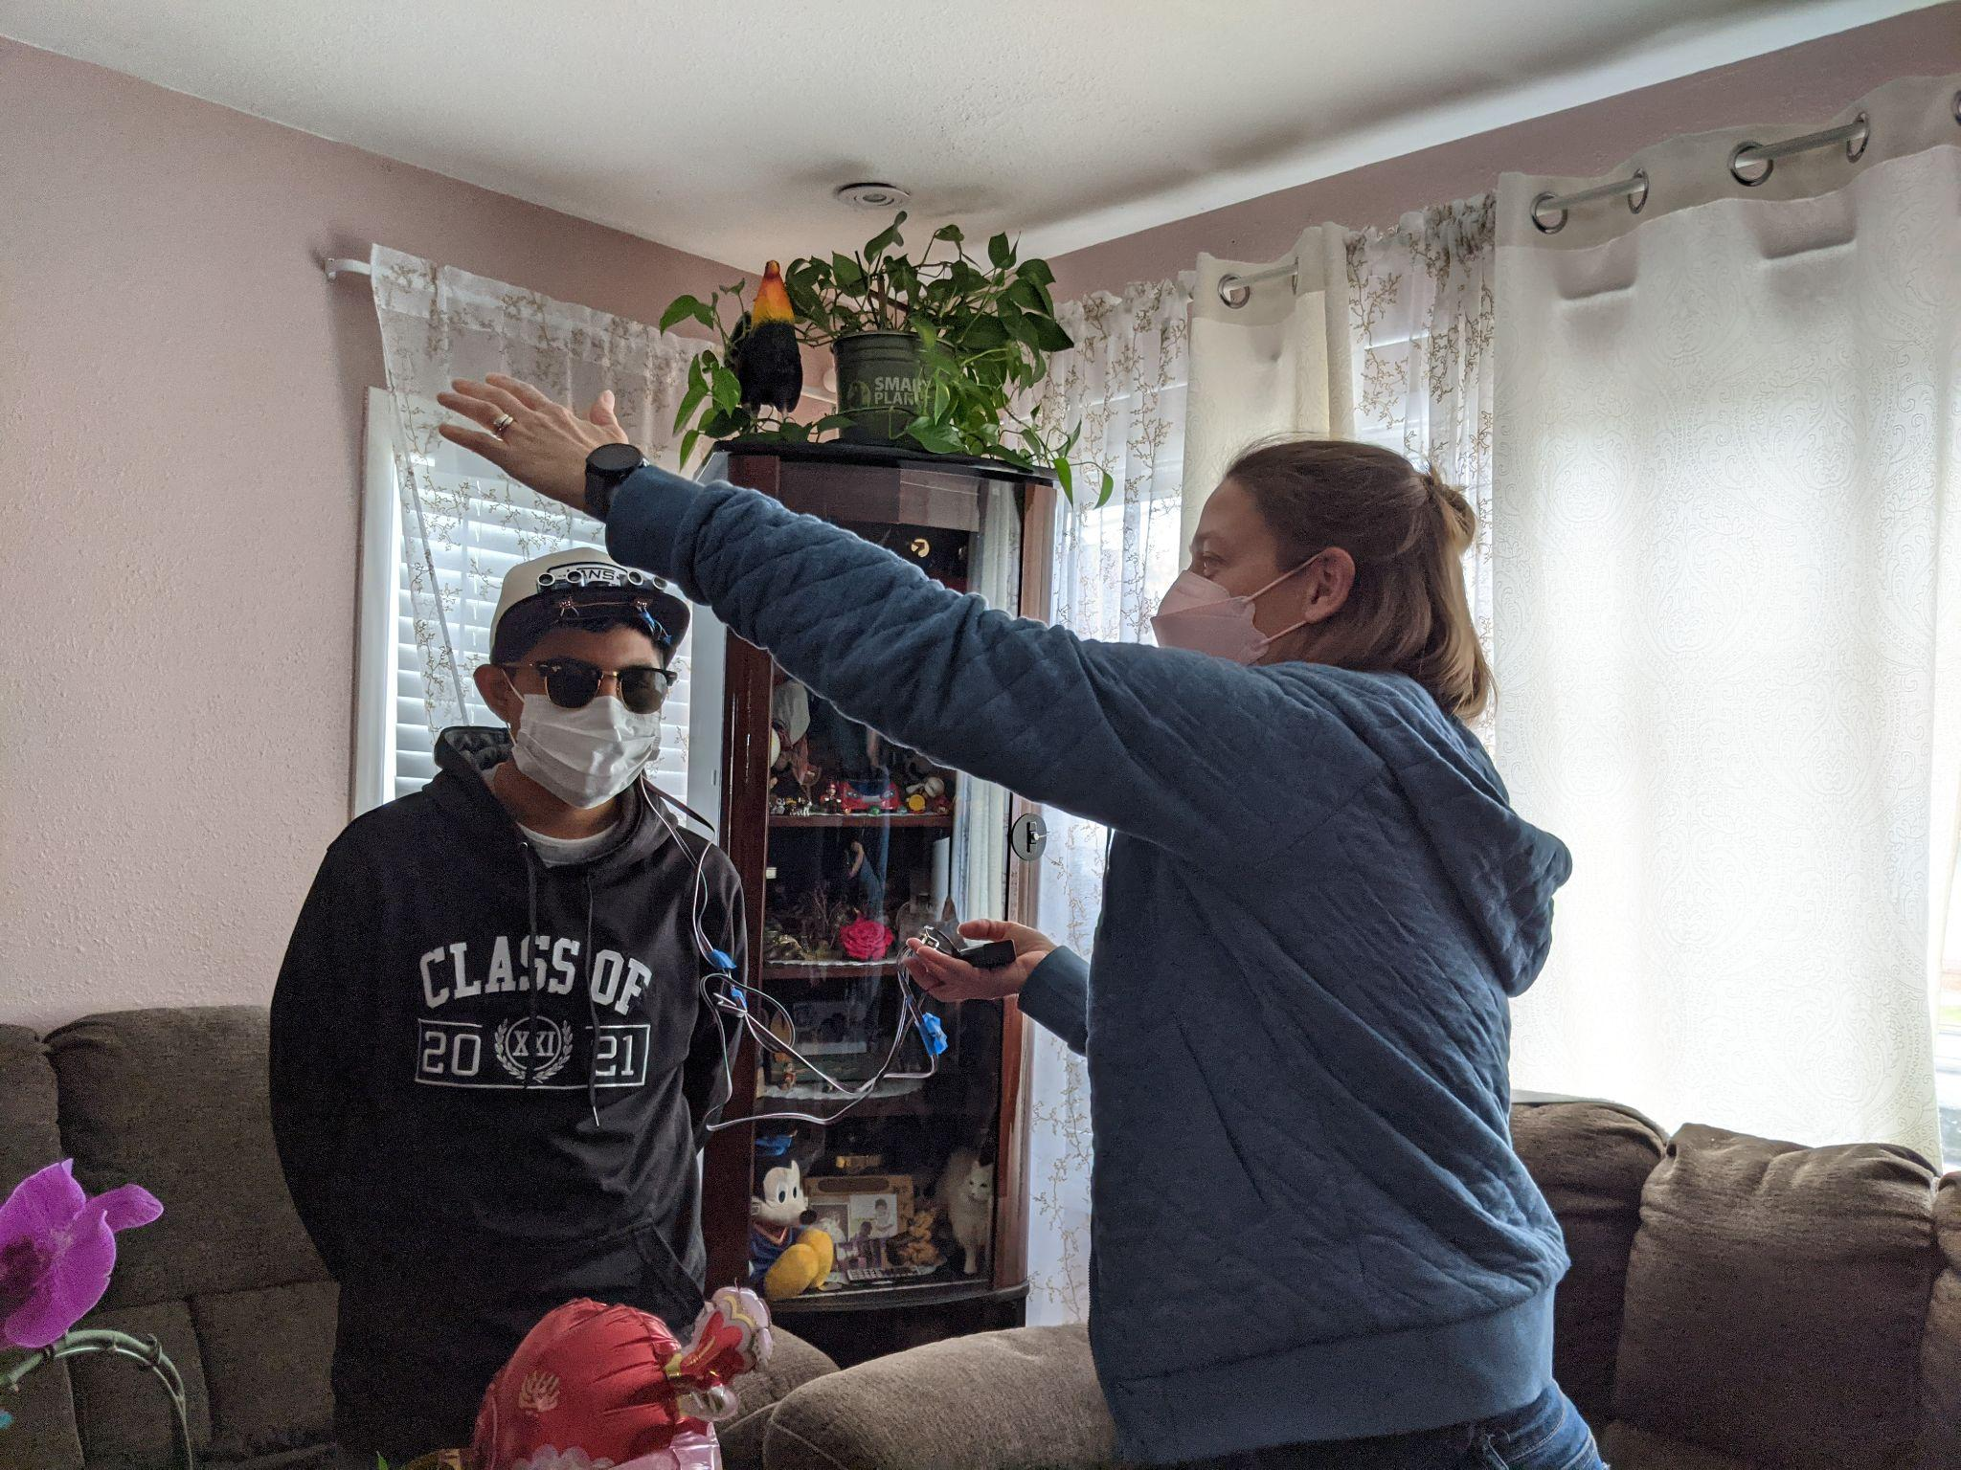
User Testing
How we tested the prototype
Omar wore the hat and put his arm at head level to see if he felt vibrations.
We made sure the vibrations were not too intense.
Learned more about Omar’s overhead problem (sideview mirrors on large trucks are his most prevalent issue with overhead objects)
He was excited about the prototype
Notes:
Grace
In order to test our prototype, our teachers drove down to meet Omar. The prototype worked fairly well and Omar seemed enthusiastic about getting it working even better. His family was there, and they also seemed excited. Something his dad mentioned was that when trucks are parked on the road and their side mirrors are sticking out, they are a hazard. At the Hatlen center, they teach them to walk with their hand up to avoid things like that. So they felt that the device would be a big help. The amount of vibrating seemed good and it was able to differentiate left from right.

Slide 12
Testing Feedback From Our Teacher
“The prototype worked fairly well and Omar seemed enthusiastic about getting it working even better. His parents and sister were there too and…they also seemed excited…”
Notes:
Rehaan
After our testing was done, out teacher mention about the tests, “ “.

Slide 13
Competitor Matrix
Product | Features | Cost
WeWalk Cane | Portable Voice assistant Connected to an app GPS | $500-599 USD
UltraCane | Dual range Narrow beam technology | $803 USD (£590)
iGlasses | Durable Vibrations Lightweight | $143.95 USD
Notes:
Nohami
All of these products are similar to the product we have now, they all aid those who are visually impared and have trouble detecting objects that are at their eye level. They all use different ways to notify their user but they do share some common qualities such as portability. Although they have similar qualities and features, their costs are vastly different.
Talk about how there is high cost
common aspects
transition to next speaker

Slide 14
Next Steps
First
Second
Third
Fine tune the angle and range
Make the controller more compact and hide the wiring
Add water protection to sensors
Notes:
Aadi
Although we currently have a working model of our prototype, we still have a lot to improve upon.
For one, we would like to continue fine tuning the angle and range the sensors provide to the user. Furthermore, we still have to make the controller more compact so that it weighs less and takes up less space in the hat, and hide the wiring that is still visible which could be damaged due to exposure to the elements or wear and tear from usage itself.
In addition to the controller and wiring, we also need to make the ultrasonic sensors resistant to the elements, which could be done by adding enclosures for the sensors.

Slide 15
THANK YOU!

